Slide 1
NEVADA TRANSPORTATION CONFERENCE
Innovations in Communication
MAY 2024
Notes:
Story to intro…
-super monotone voice, “This is _____ with the ____ police_____...”
-my first instinct - brace myself for horrific news. I’m scrambling to take mental stock of the location of all of my immediate family members.
-and then he keeps talking, in the monotone, disengaged voice…
-“Our men and women in blue risk their lives…”
-I breathe a sigh of relief - a telemarketing call
-and the asks begin
-“Can we send you an envelope and count on your support”
-no thank you but I appreciate your call (perhaps sounding a bit too cheery since no one I know has died)
-the reading from the prompt continues…and here’s where it goes off the rails for me – he moved to the next box on his script. I’m now talking to a robot and I’m a bit irritated. Where’s the humanity?!
-this is not a conversation…

Slide 2
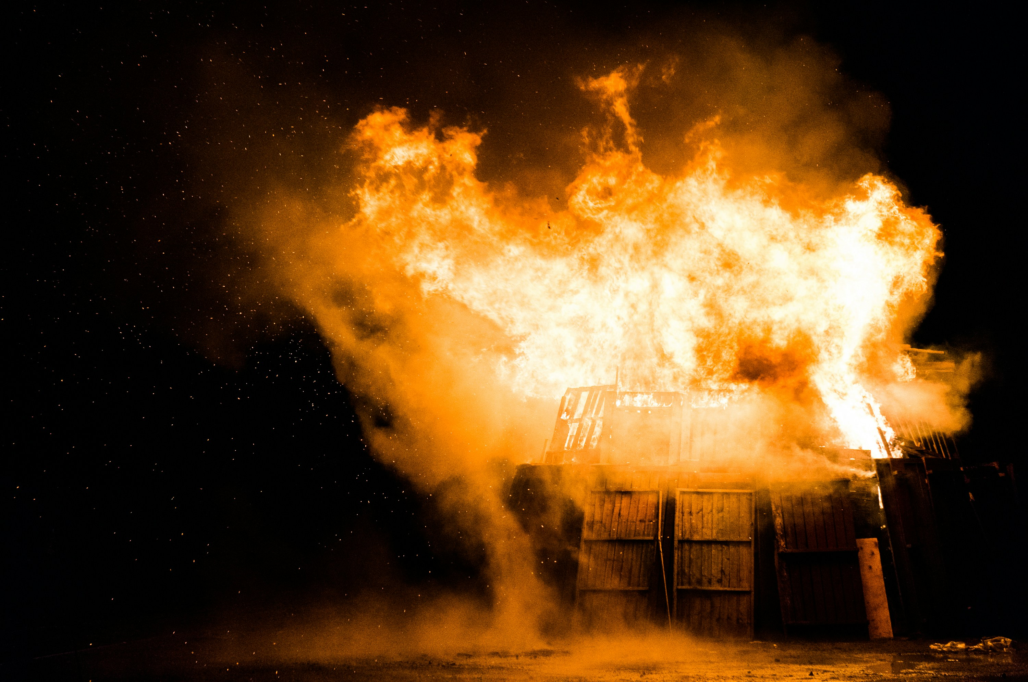
Photo by Stephen Radford
Could this have turned out differently?
Orange PEN Communication Group
Notes:
-Eventually I hung up. (which is rather uncharacteristic of me)
-would an actual conversation have changed the outcome?
Can I send you an envelope and some information, at no cost to you?
No thank you, but I appreciate your call
Ok. So what’s the barrier for something so non-committal as receiving an envelope, “Do you not like your mailperson and fell the need to avoid them at all cost?”
-To which I would reply, “Haha…no, I just don’t want you to spend the money and go through the trouble when I’m likely not going to send you money.”
-Why not? And just curious. Do you feel it’s not a worthy cause?
-Not at all, my husband, my son, blah, blah, blah…It’s a cause I believe in but I feel I’ve paid my dues so to speak.
-I totally get that. While you may not have been the officer, I realize there’s a unique burden on those closest to them. So thank you for your support. And I hope it’s okay. But I’d like to send the information to you because there is more to what we do then just ask for donations. I have a feeling there is something you will connect with.
A huge opportunity was missed…The barrier of checking boxes!!!
-How do we literally flip the script or more like burn it to the ground and make way for innovation in the area of communications.
-That’s the goal right? Just like with design, construction, maintenance, safety…is there an efficient way to communicate that is not only efficient but one that creates a level of resiliency?

Slide 3
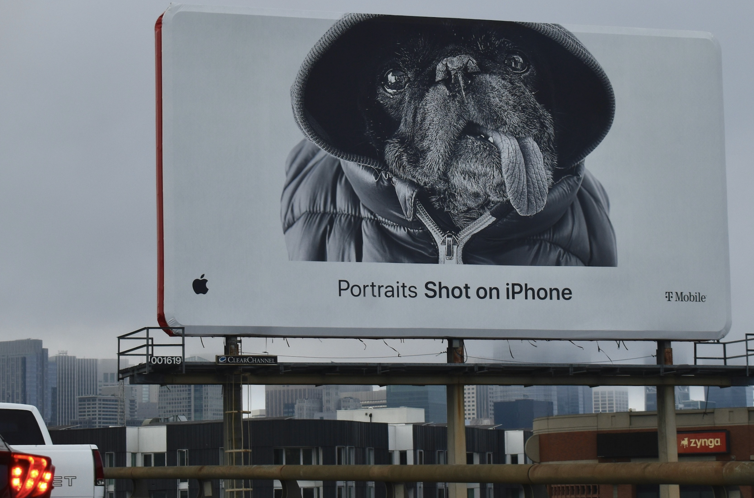
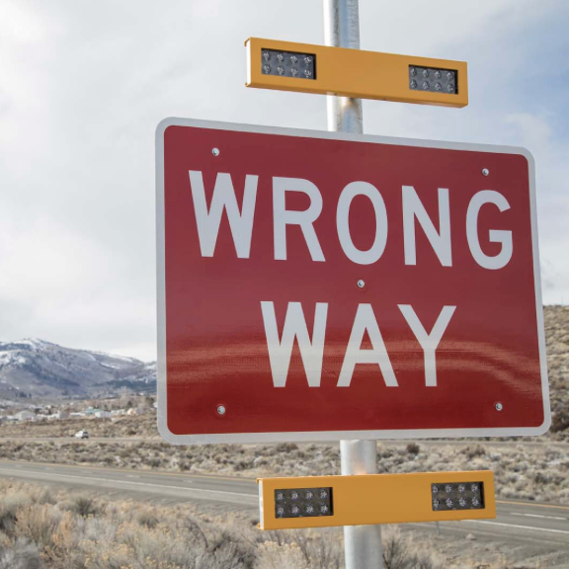
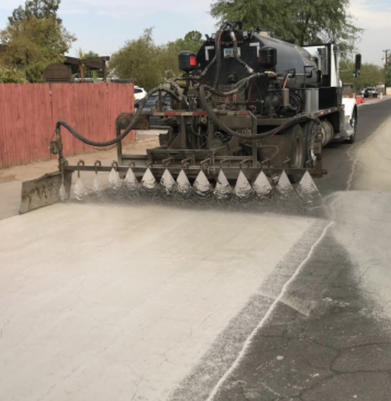
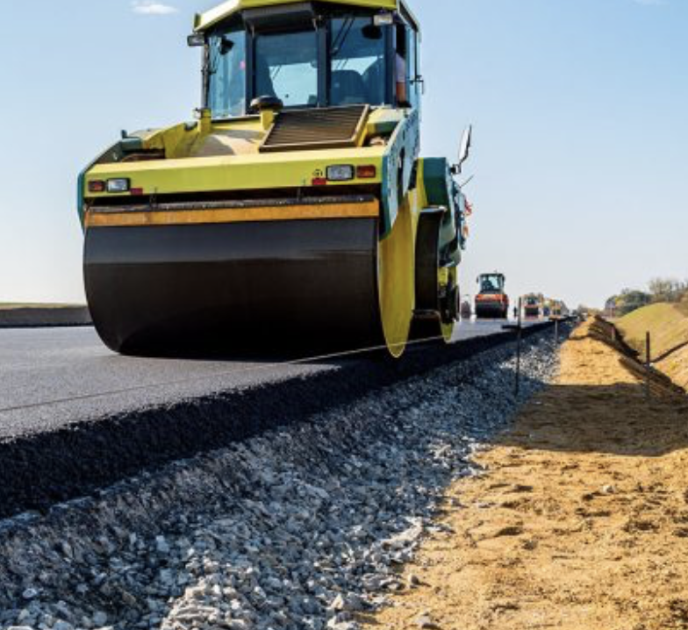
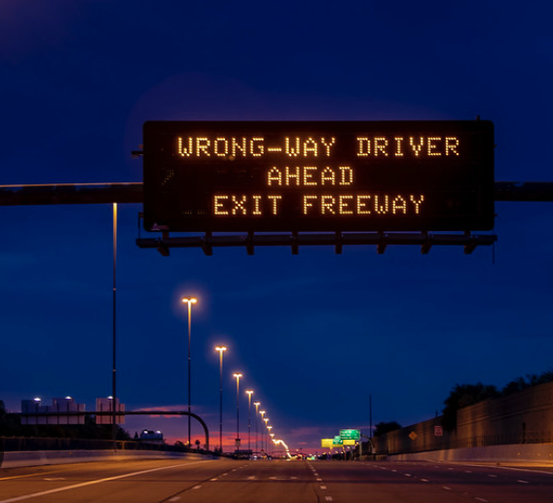
COLD PAVEMENT
WATER-SAVING PAVEMENT
INNOVATION IN TRANSPORTATION
SAFETY STRATEGIES
DYNAMIC MESSAGING
Orange PEN Communication Group
Notes:
The transportation industry looks for sustainability and resiliency through innovation.
-cool pavement
-stormwater and environmental advancements
-safety innovation
-utilizing technology with dynamic messaging
But what about the broader scope of communications?

Slide 4
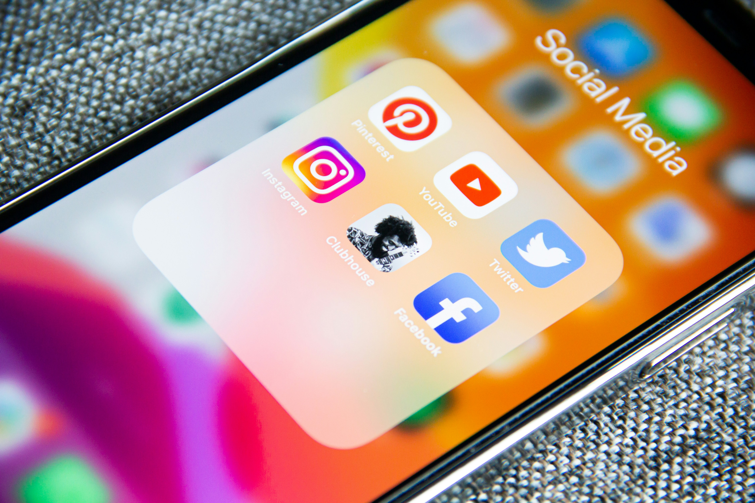
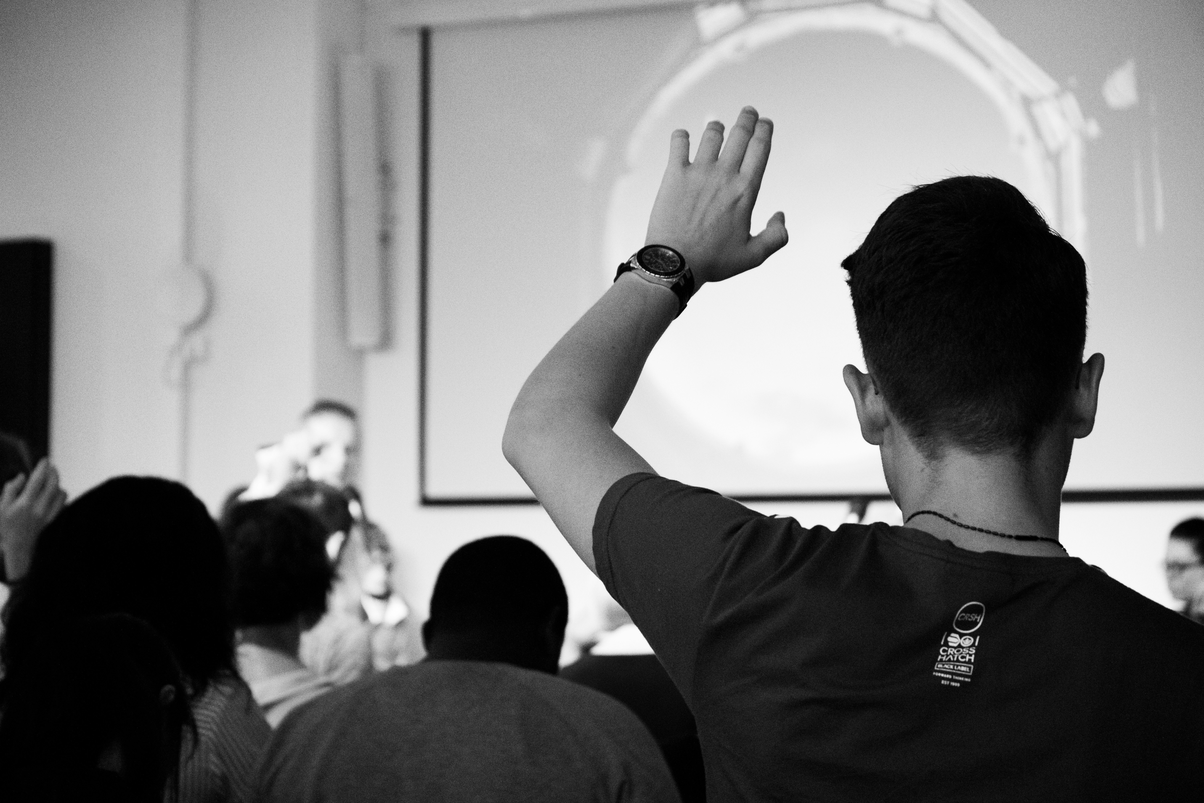
COMMUNICATIONS
Orange PEN Communication Group
Notes:
I think part of the problem comes with the definition. When I tell people I started a consulting business in communication, I get a lot of blank stares.
Communications covers such a huge and diverse set of modalities.
Other areas of innovation are quantitative – safety, green house gas emissions, resiliency of materials – but when it comes to communications, we approach it with a much more qualitative mindset.
Even the words we use to discuss are nebulous, literally. The cloud? It’s like we aren’t even trying.

Slide 5
NEWSLETTERS
DYNAMIC MESSAGING
WEBSITES
COMMUNICATIONS
PUBLIC OUTREACH
SOCIAL MEDIA
SURVEYS
Orange PEN Communication Group
Notes:
Communications is the foundation of everything we do.
Which sounds self serving given my business focus but I chose to go into this field for that reason. It’s fundamental to every aspect.
Which creates a unique challenge. Essentially, we are trying to get better at something foundational while also being successful at all the other parts needed to deliver our programs.
Perhaps the logical first step is to define communications. Figure out where the boundaries are so we can quantify the issue.
Here are a few tangible tools we use in the communication space.
But this is not an exhaustive list.
(pause) then click forward
What’s missing from the list?
-emails
-press releases
Hundreds and thousands of communications daily, internally and externally, using a plethora of methods…

Slide 6
5
steps
5
4
3
2
1
Orange PEN Communication Group
Notes:
Here we go…

Slide 7
BE INTENTIONAL
If it’s not on purpose, why do it?
5
4
3
2
1
Orange PEN Communication Group
Notes:
Step 1 – I could have possibly boiled this presentation down to one step but I have a whole half hour…
Innovative communication is all about the endgame. Be intentional about where it is you want to end up. We often use the casting of a wide net approach instead of laser precision approach. And while we may have a good answer for the broad picture, I think it’s easy to lose sight of the small opportunities.
Think about this the next time you are sitting down to write a routine email, ask this question. “Why am I doing this?” A response is expected? Appeasing a disgruntled colleague or someone from the public? Checking a box? Refer back to the dumpster fire slide.
-Every communication is a potential step toward a desired outcome. While you cannot control reactions, knowing why or what our intent is, can help bring resolution to conflicts. The trick here, knowing what they why is - transparency, accountability, trust, information, correcting a false assumption…
“If you don’t know where you are going, you might end up somewhere else.” Yogi Berra
Who is your audience? What is the desired outcome? What is the urgency? (Side note, urgency is like salt. It’s useful but works best in moderation.)
This also applies in the context of meetings. You know that saying, “This meeting could have been an email.” It’s funny because it’s true!! Unless you have a specific objective for putting a meeting together, don’t do it!
“But I don’t call the meetings…”
You are not off the hook. You can still be intentional. I’m going to sit next to someone I don’t know well and try to connect. Or, I’m going to share my piece once during the meeting…or if you are more like me…I’m going to limit myself to one share!
Find an intention! What’s the goal? Then move toward your goal on purpose and with intention. You just created your own communication plan and can utilize each object of communication toward that goal. Work smarter, not harder.

Slide 8
PRIORITIZE
You can do all the things…just not at the same time.
5
4
3
2
1
Orange PEN Communication Group
Notes:
You can have all the things…just not at all at once.” Betty Frieden an author and activist..
Chance are good that you are going to find multiple goals that you want/need to accomplish.
Prioritize. And sometimes it’s not always moving forward. Are there holes or gaps, or relationships that need to be patched before effectively moving forward?
Sometimes it might feel like going backwards or losing time but will it be better in the long run?
What is a logical first step or foundational step? Is there something you can do now that will lend to achieving other goals faster? What infrastructure is needed?

Slide 9
BUILD TRUST
Communication is about people and people can be tricky.
5
4
3
2
1
Orange PEN Communication Group
Notes:
Just like the previous slide, where you can’t do everything all at once, you can’t do anything effectively by yourself. The most resilient methods of communications are those that build relationship. And relationships come from building trust. So start building trust.
And I’m finding this is not an intuitive practice. It may sound easy but I think this is where the path turns into the more subjective part of communication. People are tricky.
How? How do we build trust?
First, follow steps one and two. This presentation is not a choose your own adventure book. There is a rationality to the progression of steps. Get out of the checking the box mentality first, then, start asking questions. This is where assumptions get murdered. They are toxic, undermining ideologies that do nothing more than burn bridges.
Whether you are developing channels of communication with the public, with your division, your team, or your coworkers, this is fundamental. Be trustworthy. Sometimes this means falling on the sword and owning mistakes to demonstrate you are willing to learn and you are willing to lead.
Prioritize your intentions and then start connecting and building bridges.

Slide 10
BUILD MORE TRUST
Trust is like fuel… the more you have, the further you can go.
5
4
3
2
1
Orange PEN Communication Group
Notes:
Trust is earned in drops and lost in buckets.
Keep adding drops.
There’s a pretty definitive way I can illustrate this. I used to play would you rather with my students and my favorite thing was blowing their easily molded minds. Before opening a new concept, we would spend some time discussing a story or graph for the sheer fun of exploring something new, hoping to create some connection to the information that was on its way.
The Grain of Rice fable from India. Would you rather have a penny, that doubles every day for 30 days, or would you rather have a million dollars?
Day 1 - $0.01
Day 2 - $0.02
Day 3 - $0.04
Day 4 - $0.08 – 16 – 32 – 64 – 128 - 256 – 512 – 1024 (day 11) – 2048 – 4096 – 8192 – 16,384 (day 15) – 32,768 – 65,536 – 131,072 - $2621.44 – day 20 ($5242.88) – day 30 ($5,368,709.12).
This was the intro to discuss exponential growth.
I think trust has an exponential growth pattern. Trust turns into more trust, which turns into relationship, which turns into loyalty, which turns into a strong and positive moral. Or if we are talking external, it turns into a strong partnership with a stakeholder.
Or if you are more of a law of thermodynamics kinda person, let’s take a look at the Law of entropy. Decay of systems is inevitable without the application of energy into the system. Like pavement. There comes a point when preservation measures go along way. Keep investing energy into the communication systems in which you participate.

Slide 11
ASSESS
Rinse and repeat…with modifications as needed.
5
4
3
2
1
Orange PEN Communication Group
Notes:
Are the methods employed moving us in the direction we want to go?
Not all communication is created equal. What is working and what isn’t?
Part of the struggle I see with surveys and other methods of gathering data, is the habit to begin here, at step 5. This is step 5 on purpose.
You might say it’s intentional.
If you don’t know what the goal is, how do you know what to measure? And if you don’t know where you want to be, how can data be applied to make any changes to current methods?
This is where things come full circle.
Intention should set the framework for assessment and then the assessments inform the clarification of the intention. Data collected to check boxes creates a type of paralysis. What we do with all of this information? Paralysis breeds inaction, which tends to undermine trust.
But targeted assessments can be extremely valuable. Are the methods employed creating the desired results? If not, why? What can be done differently? Adjust the priorities, build trust by communicating the results and the changes being made and why.

Slide 12
INNOVATION
BE INTENTIONAL
PRIORITIZE
BUILD TRUST
BUILD MORE TRUST
ASSESS
Orange PEN Communication Group
Notes:
Innovation is about finding ways to utilize current technologies and advancements to ensure efficiency and resiliency.
What if we looked at these five steps in a different context – relationships in general
Intention – get to know this person
Prioritize – do I want to spend all my time with this person
Build trust – the foundation to any healthy relationship
Assess – is this going where I thought it would? Do I want to keep going down this road?
And then the cycle repeats…
Communication will always be about people. And I could argue that people are fundamentally unchanged for thousands of years.
We still look for connection and a sense of belonging.
It’s easier to use lists with boxes to check or flow charts when it comes to communication. Like the telemarketer call. But we have all felt the frustration of not being heard, or feeling like your talking to a wall. So why keep creating those moments for others?
That’s why I strongly believe the future of innovation in communication looks exactly like intentional connection.
Thank you for your time this morning.
Questions?

Slide 13
Orange PEN Communication Group
Rebecca Qualls
rqualls@orangepencomms.com
www.orangepencomms.com
775-508-3658

